Slide 1
The Tunnel + Transit Solution for Alaskan Way Viaduct

Slide 2
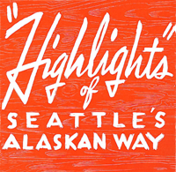
Alaskan Way Viaduct Quick History
1953 Central Viaduct Opens
1985 University of Washington study identifies problems
2001 Nisqually Quake
70+ Alternatives Evaluated
2004 EIS
2006 SEIS 2 Preferred alternatives:
2007 Seattle Voters reject both alternatives
Project Team is created and selects 30 stakeholders
Dec 11 Project Team recommends Surface and Elevated ; Stakeholders say Tunnel + Transit
Dec 12 Stakeholders meet with Project Team and outside Tunnel experts
← Brochure from Grand Opening Party 1959

Slide 3
Quick History -2
2009 Jan 13 Governor, Mayor, County Exec, endorse Tunnel + Transit
House votes 52-43 in favor of Tunnel + Transit
Senate votes 39-9 in favor
Transportation Budget approved
77-19 in House
41- 9 in Senate
Seattle City Council approves 9-0
Today KOMO “We are very deeply committed to proceeding with the tunnel project”

Slide 4
Looking Forward
Nov 16 Qualifications due
December Short list identified
2010 January Traffic and Revenue studies due to Legislature
-- Includes tolling analysis
--Updated costs due too
Draft SEIS-2 due
March Final SEIS-2 due
King to Holgate (south mile) begins
Fall Proposals due
Tunnel contractor selected
2011 EIS Record of Decision
2012 Seawall replacement begins, Tunnel begins
2015 Tunnel opens, viaduct comes down
2017 Waterfront promenade completed

Slide 5
Alaskan Way Viaduct Stakeholders
Interest Groups Labor Business Neighborhoods
Transportation Choices KCLC DSA NE & NW Seattle (2)
FutureWise ILWU Chamber Southeast County
People for Puget Sound Pike Place
Waterfront
Sierra Club Maritime Belltown
People’s Waterfront BINMIC Uptown
Working Families Elevated Stadiums International District
Allied Arts Manuf Ind Council Ballard/Fremont (2)
Cascade Bike Club West Seattle (2)
Southwest County

Slide 6
Alaskan Way Viaduct Guiding Principles
6 Principles and 27 Measures to Evaluated Alternatives
Improve Public Safety
2. Provide Efficient Movement of People and Goods, Now & Future
3. Maintain or Improve economies: Seattle, region, port, state
4. Enhance Waterfront, Downtown, Neighborhoods for People
5. Solutions that are Fiscally Responsible
6. Improve Health of Environment

Slide 7
Alaskan Way Viaduct Winnowing Scenarios
January June December 11 January 13
Hybrids Emerge
A Demand Mgmt/ Low Capital Demand
B Surface Boulevard AK Way Surface
C Alaskan Way Couplet Couplet Couplet
D 4-Lane Elevated Elevated Elevated
E Integrated Elevated Integrated
F Bored Tunnel Bored Tunnel Bored Tunnel
G 4-Lane Cut & Cover Tunnel Cut & Cover + Transit
H 4-Lane Lidded Trench Trench
I Alaskan Way Surface X-Way
J Retrofit
K Elliott Bay Bridge

Slide 8
The Tunnel + Transit Solution
 | Proposed Project Implementation Responsibility |  |  |  | Costs
 | State | King County MVET | City of Seattle | Port of Seattle ***
Moving Forward and Prior Expenditures | $600 million |  |  | $300 million | $900 million*
SR 99 Bored Tunnel | $1.9 billion** |  |  |  | $1.9 billion
Alaskan Way Surface Street and Promenade | $290 million |  | $100 million |  | $390 million
Central Seawall |  |  | $255 million |  | $255 million
Utility Relocation |  |  | $250 million |  | $250 million
City Streets and Transit Pathways |  | $25 million | $190 million |  | $215 million
Transit Infrastructure and Services |  | $115 million | $135 million |  | $250 million
Construction Transit Service | $30 million | $50 million |  |  | $80 million
Total | $2.82 billion | $190 million | $930 million | $300 million | $4.24 billion
Transit Operations Annual Cost |  | $15 million |  |  | $15 million
*Reflects cost savings from Moving Forward program realized by not repairing the viaduct from Lenora to Battery Street Tunnel and not completing the second phase of fire and life safety upgrades to the Battery Street Tunnel.
**Reflects the most likely cost based on a conceptual design. The potential cost range is between $1.2 billion and $2.2 billion.
***Agreement in concept for up to $300 million subject to Port of Seattle Commission review and approval.

Slide 9
Program Timeline
2008 | 2009 | 2010 | 2011 | 2012 | 2013 | 2014 | 2015 | 2016 | 2017
Relocate electrical lines between S. Massachusetts Street and Railroad Way S.
Replace the viaduct between S. Holgate and S. King streets
Implement Moving Forward transit
enhancements and other improvements
Mercer Street construction from I-5 to Dexter Avenue
Mercer West from Dexter to Elliott avenues
S. Spokane Street Viaduct Project construction
Bored tunnel env. documentation
Bored tunnel construction
Transit capital
Transit service enhancements
Alaskan Way and waterfront promenade construction
*Seawall construction will take place before Alaskan Way and promenade construction

Slide 10
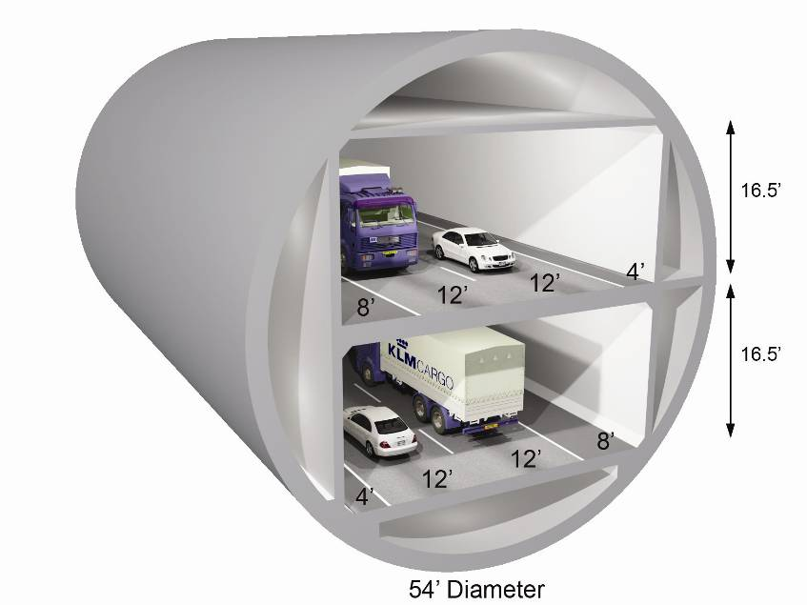
Bored Tunnel Hybrid Alternative
Tunnel Particulars
SR 99 Tunnel:
54’ diameter, single bore tunnel.
Two lanes of traffic in each direction.
Approximately 9,000 ft King to Harrison
Between 30 and 200 feet underground.
Construction is expected to begin in 2011 and be open to drivers in 2015.
Alaskan Way surface street:
Four-lane roadway with two lanes in each direction.
Carries approximately 25,000 vehicles per day.

Slide 11
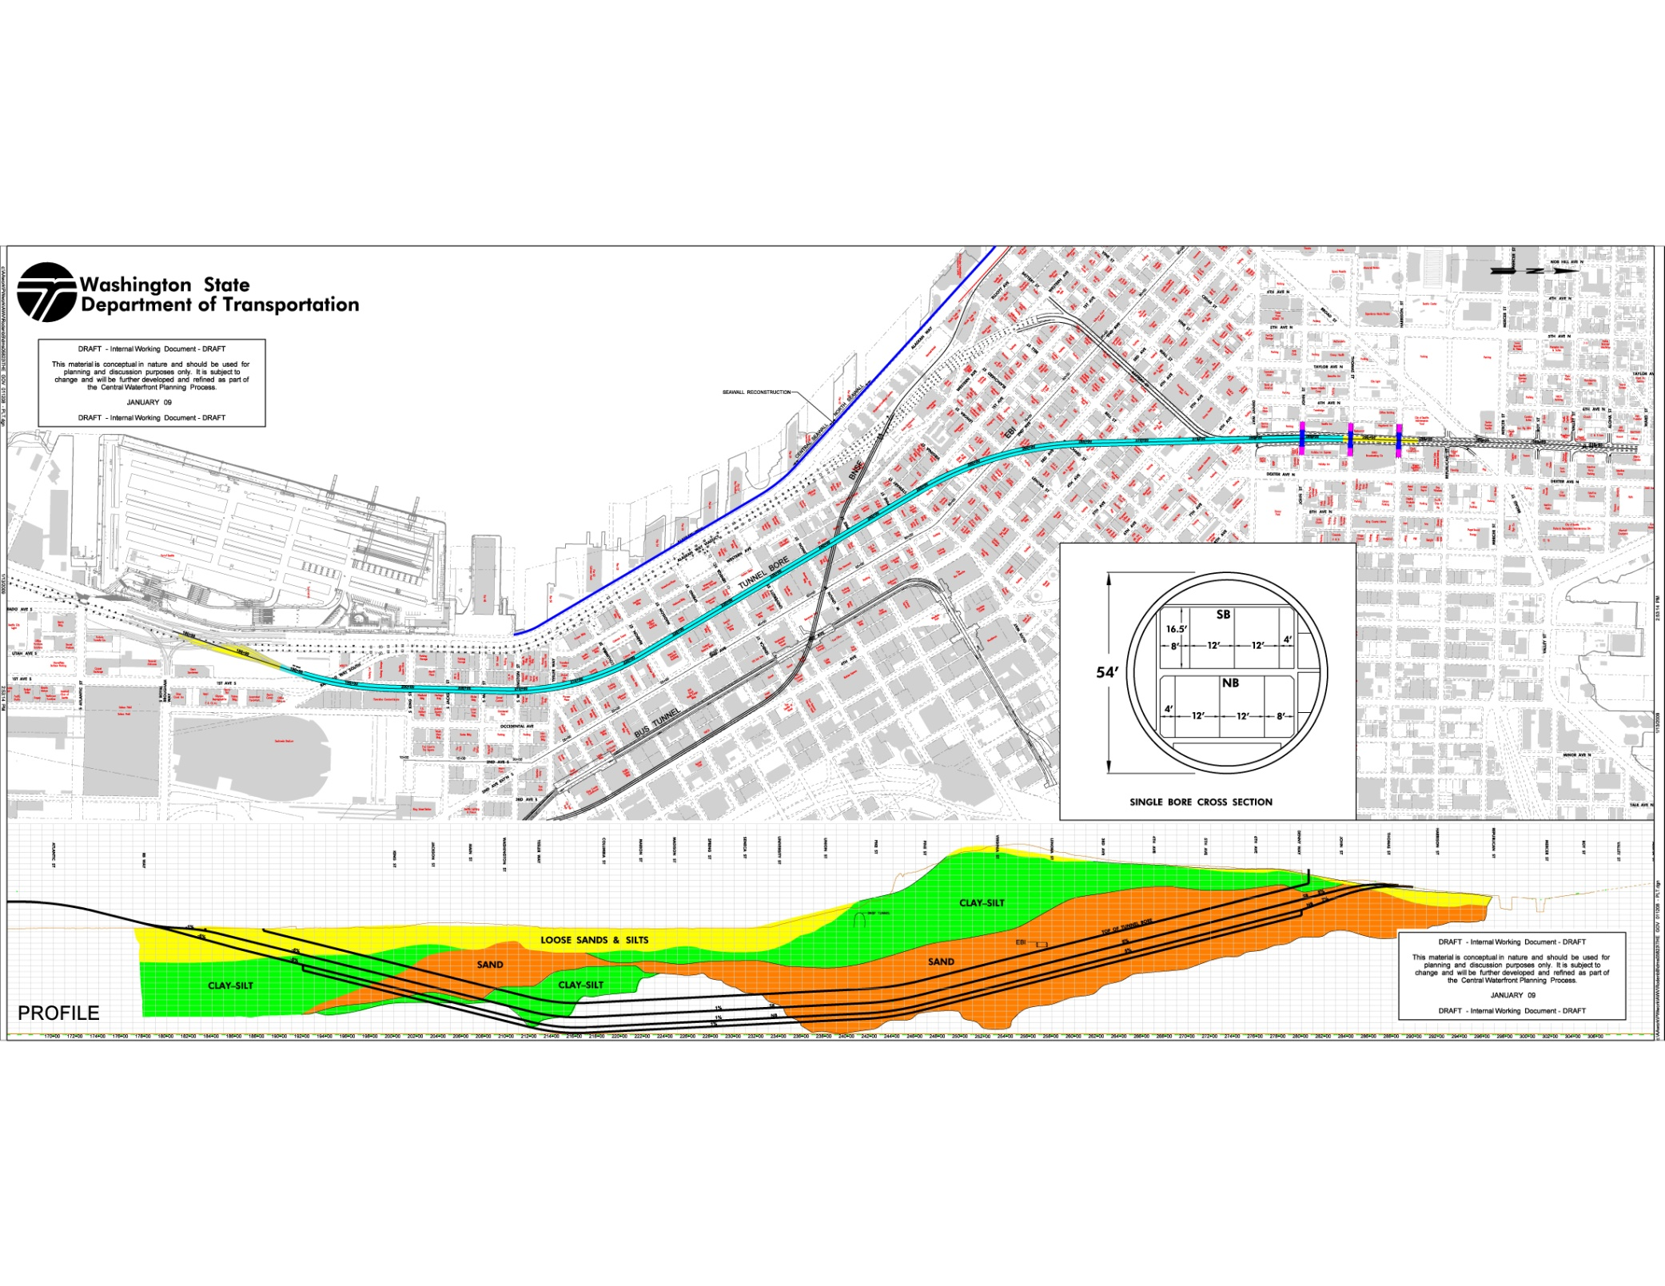
Tunnel Routes and Soil Types

Slide 12
Why Is Seattle’s Tunnel Not The One Voters Rejected?
Now Then
Bored Cut and Cover
Below First Avenue At seawall
Up to 200 feet below ground 10 feet below ground
Existing Viaduct stays open Viaduct closed 3.5 - 7 years
Construction time 4.5 years Construction time 117 months
Limits impact to downtown, water Would have killed downtown, waterfront

Slide 13
Why is Seattle’s Tunnel Not Boston’s Big Dig?
Seattle Boston
Less than 10% paid with federal $ 80% paid with federal dollars
1 Deep Bore tunnel 2 Interstate Hwys + intersection
2 multi-lane Cut & Cover underneath Major Elevated Sections & Ramps
Largely glacial till & clay Poor geotechnology conditions
2.8 miles 8 miles
12.8 lane miles 161+ lane miles
No bridge Includes signature cable-stayed bridge
No water 2 tubes sunk in Boston harbor
Minimal disruption with viaduct $4B mitigation (30% of budget)
Arguments before construction Project grew over time, delays, scope

Slide 14
World’s Deep Bore Tunnels
Majority of projects indicate a cost per mile of single tunnel of less than $350 million. This equates, for two tunnels 10,000 ft long, to $1.2 billion.
Notes:
Costs are reported project costs, and have been normalized to indicate the cost of a mile of single tunnel
No price escalation has been incorporated
Costs for I-710 project in Los Angeles are from feasibility study – project is not built
Alaskan Way figures based on $2.8bn for twin 10,000ft long tunnels

Slide 15
Critical Issues Open
17,000 vehicles a day to NW Seattle
How does the North Portal work—Mercer Street, esp West Mercer?
How does the South Portal work?
What is design of Central Waterfront?
Financing — City
Financing — County
Financing — Port
Project is at less than 15% design, so there is plenty of time to solve

Slide 16
